Slide 1
The Italian Affair App Design
Vardaan Narang

Slide 2
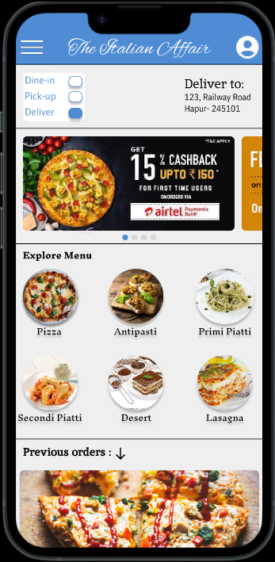
Project overview
The product:
The Italian Affair is an italian restaurant situated in a small town named Hapur. It strives to provide the best italian food in the town. They offer a wide variety of authentic and healty italian dishes with wide spectrum of competitive pricing . The Italian Affair targets everyone who loves italian food.
Preview of selected polished designs.
Project duration:
December 2022 to January 2022

Slide 3
Project overview
The problem:
Busy workers and communers lack the time to sit and wait for the meal to prepare.
The goal:
Design an app for the Italian Affair that lets the users to easily order food before reachng the restaurant.

Slide 4
Project overview
My role:
UX designer designing an app for The Italian Affair.
Responsibilities:
Conducting interviews, paper and digital wireframing, low and high-fidelity prototyping, conducting usability studies, accounting for accessibility, and iterating on designs.

Slide 5
User research
Personas
Problem statements
User journey maps
Understanding
the user

Slide 6
User research: summary
I conducted interviews and created empathy maps to understand the users I’m designing for and their needs. A primary user group identified through research was working adults who don’t have time to wait for the meals to be prepared and are always in a rush.
This user group confirmed initial assumptions about The Italian Affair’s customers, but research also revealed that time was not the only factor limiting users from cooking at home. Other user problems included obligations, interests, or challenges that make it difficult to get groceries for cooking or go to restaurants in-person.

Slide 7
User research: pain points
1
2
3
Accuracy
IA
Accessibility
Waiters in restaurant often tend to make mistakes while bringing order.
Text-heavy menus in apps are often difficult to read and order from
Platform for ordering food are not equipped with assistive technologies

Slide 8
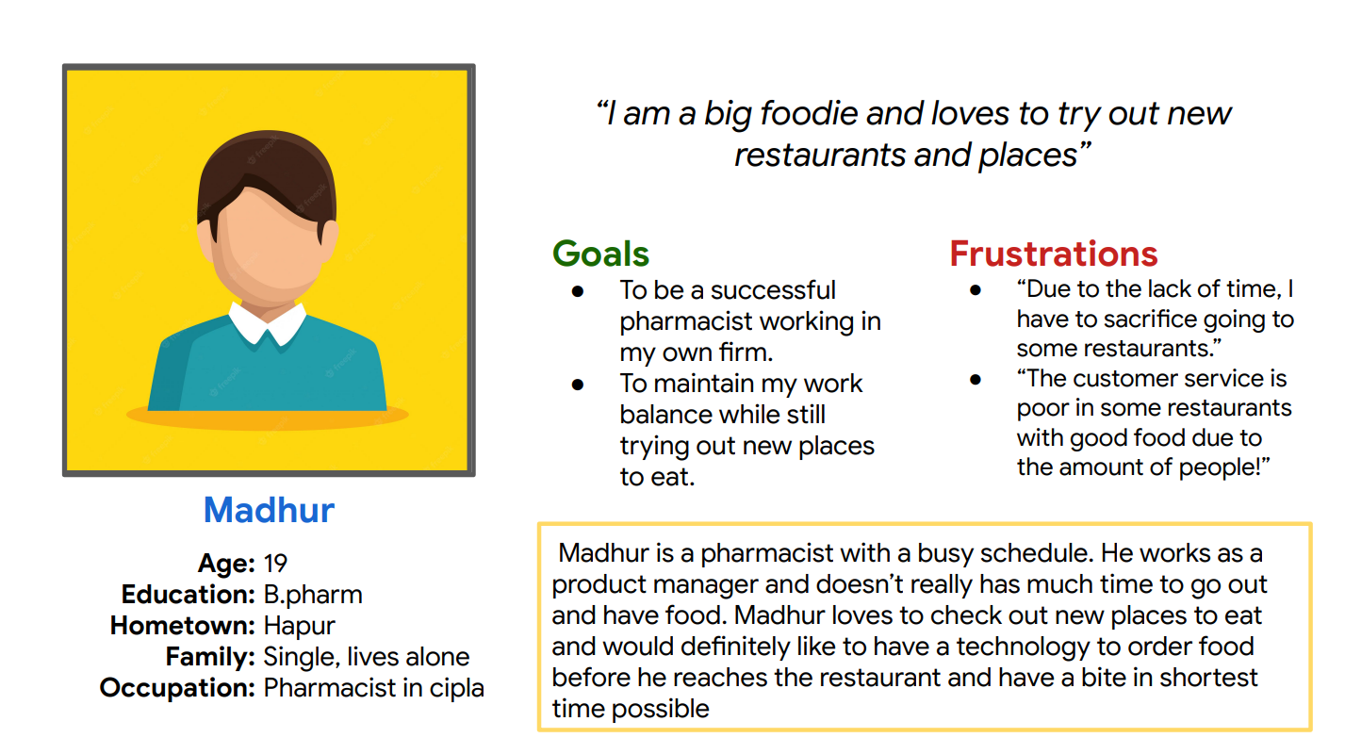
Persona: Name
Problem statement:
Madhur is a busy working adult who need quicker access to food when he’s eating out because he has no time to wait in lines to order.

Slide 9
Action | Find a Restaurant | Book a table | Go to the restaurant | Order food | Eat food and checkout
TASK LIST | Tasks: A. Search for a restaurant nearby B. Read about the reviews of the place C. Ask his family members about the same | Tasks: A. Call the restaurant to book a table B. Tell them the number of people | Tasks: A. Get ready and sit in your car with family B. Go to the restaurant C. Get out of the car | Tasks: A. Look at the printed menu and select the food items that you want to order B. Wait for the waiter to arrive and collect your order C. Confirm the order | Tasks: A. Wait for the food to arrive B. Eat your food C. Give the waiter a tip and pay at the checkout counter
EMOTIONS | User emotions: A. Excited about going out with his family B. Sceptical if the family members would like the place he chose | User emotions: A. Worried about the availability of a table in the restaurant | User emotions: A. Concentrated on the driving. B. Worried as he forgot his spectacles at home and has a poor vision C. Trouble navigating to the restaurant | User emotions: A. Frustrated as he is not able to understand what is written on the menu. B. Irritated because the waiter took too much time to come and collect the order | User emotions: A. Impatient as it has been long since he placed the order and is unable to know the order preparation status B. Happy after the arrival of food as the food was tasty
IMPROVEMENT OPPORTUNITIES | Area to improve: An app that would list all the good places nearby with user reviews | Area to improve: A restaurant app that gives the users an option to book a table and provides live status about how many tables are left to book | Area to improve: The restaurant app should have the directions to the restaurant | Area to improve: A. A restaurant app that would let you order food before you even arrive. B. The app should have the feature of speech to text, high contrast text and other accessibility features for people with visual disabilities | Area to improve: A. After ordering, the app should show the food preparation status and the approximate time of food arrival. B. The app should have a feature to pay directly from the phone without going to the checkout counter to save time
User journey map
Mapping Madhur’s user journey revealed how helpful it would be for users to have access to a dedicated The Italian Affair app.
Image of user journey map

Slide 10
Paper wireframes
Digital wireframes
Low-fidelity prototype
Usability studies
Starting
the design

Slide 11
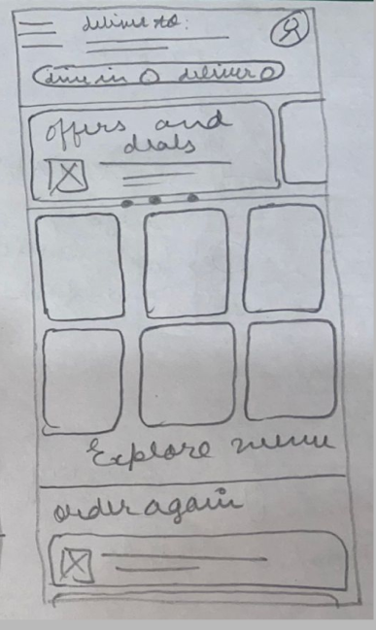
Paper wireframes
Taking the time to draft iterations of each screen of the app on paper ensured that the elements that made it to digital wireframes would be well-suited to address user pain points. For the home screen, I prioritized a quick and easy ordering process to help users save time.
Image of paper wireframes including five different versions of the same screen and one image of the new, refined version

Slide 12
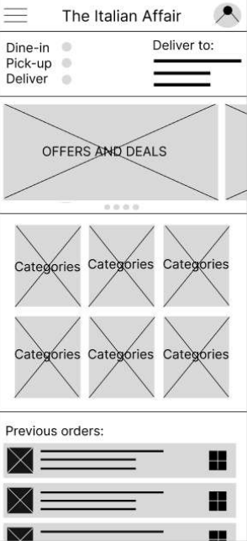
Digital wireframes
This option lets the user choose whether they want to dine-in, pick-up, or get the order delivered
As the initial design phase continued, I made sure to base screen designs on feedback and findings from the user research.
This option lets the uder choose from the various different food categories

Slide 13
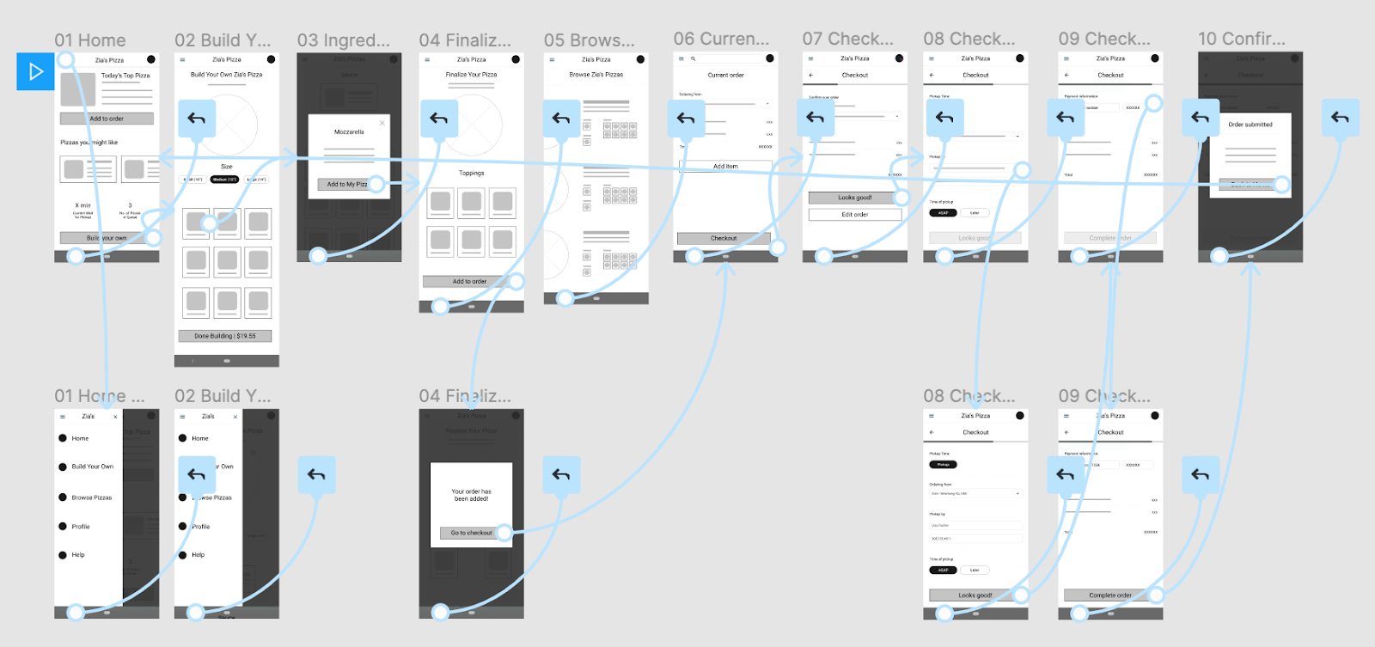
Low-fidelity prototype
Using the completed set of digital wireframes, I created a low-fidelity prototype. The primary user flow I connected was ordering a pizza, so the prototype could be used in a usability study.

Slide 14
Usability study: findings
I conducted two rounds of usability studies. Findings from the first study helped guide the designs from wireframes to mockups. The second study used a high-fidelity prototype and revealed what aspects of the mockups needed refining.
Round 1 findings
Round 2 findings
1
Users want to order food quickly
1
The delivery/dine-in/pick-up buttons were too small to tap
2
Users wanted more customization options
2
The previous orders tab was a bit confusing to access
3
Users wanted a delivery option

Slide 15
Refining
the design
Mockups
High-fidelity prototype
Accessibility

Slide 16
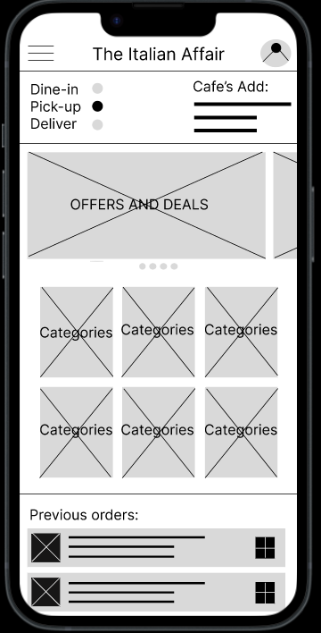
Mockups
Before usability study
After usability study
Early designs allowed for some customization, but after the usability studies, I added additional options to select if the user wants to pick-up/ dine-in/ deliver. I also revised the design so users can see the previous orders section clearly when they first land on the screen.
Image of selected screen before usability study
Image of selected screen after usability study

Slide 17
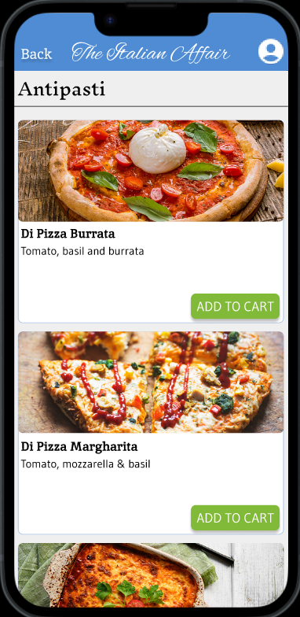
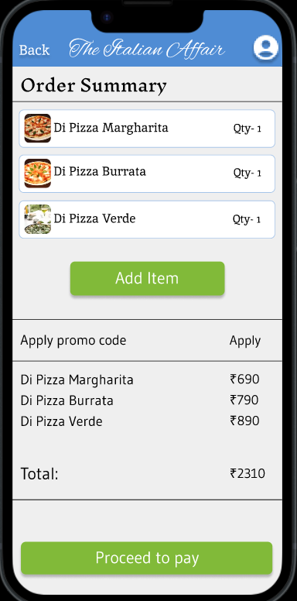
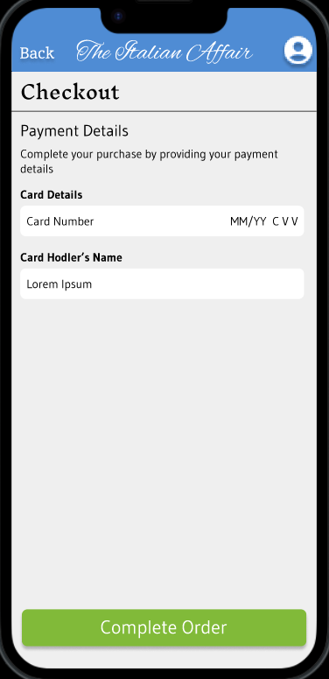
Mockups
Main mockup screen for display
Main mockup screen for display
Main mockup screen for display
Main mockup screen for display

Slide 18
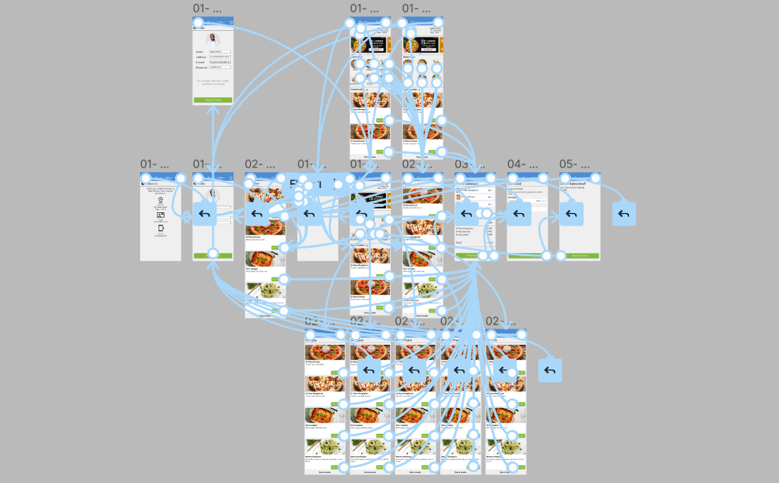
High-fidelity prototype
The final high-fidelity prototype presented cleaner user flows for ordering food and checkout. It also met user needs for a pickup or delivery option as well as more customization.
Screenshot of prototype with connections or prototype GIF

Slide 19
Accessibility considerations
1
2
3
Provided access to users who are vision impaired through adding alt text to images for screen readers.
Used icons to help make navigation easier.
Used detailed imagery for food to help all users better understand the designs.

Slide 20
Going forward
Takeaways
Next steps

Slide 21
Takeaways
Impact:
The app makes users feel like The Italian Affair really thinks about how to meet their needs.
One quote from peer feedback:
“The app made it so easy and fun to order food. I would definitely use this app as a go-to for a delicious, fast, and even healthy meal.”
What I learned:
While designing The Italian Affair app, I learned that the first ideas for the app are only the beginning of the process. Usability studies and peer feedback influenced each iteration of the app’s designs.

Slide 22
Next steps
1
2
Conduct another round of usability studies to validate whether the pain points users experienced have been effectively addressed.
Conduct more user research to determine any new areas of need.

Slide 23
Insert a few sentences summarizing the next steps you would take with this project and why. Feel free to organize next steps in a bullet point list.
Let’s connect!
Thank you for your time reviewing my work on the Zia’s Pizza app! If you’d like to see more or get in touch, my contact information is provided below.
Email: vardaannarang20@gmail.com
LinkedIn: https://www.linkedin.com/in/vardaannarang20

Slide 24
Thank you!

